Slide 1


King County House Prices

Slide 2

Hi there! I’m a software engineer based in NY and working for the UN, and an aspiring data scientist at Flatiron Academy
Barto Molina, Flatiron DS, April 2019 cohort

Slide 3
the project
sales in King County Sept ‘14 – Oct ‘15
21,597 sales
3% of the total number of houses in KC
top factors influencing the price and best locations

Slide 4
our target
House Price

Slide 5
price predictors
zipcode
latitude
longitude
waterfront
sq ft nearest neighbors
location
year built
year renovated
grade
condition
condition
bedrooms
bathrooms
floors
sq feet (living, above, basement)
sq feet lot
features

Slide 6
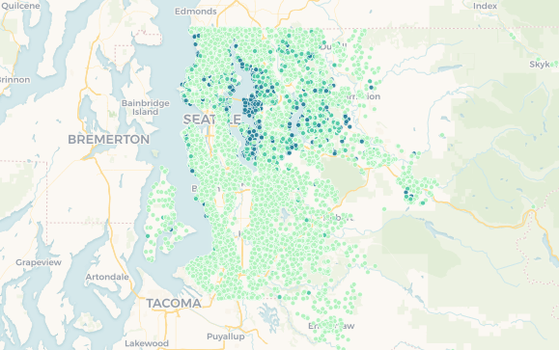
waterfront
latitude
waterfront houses 75% more expensive
moving 32 miles north increases price 1.5%
location

Slide 7
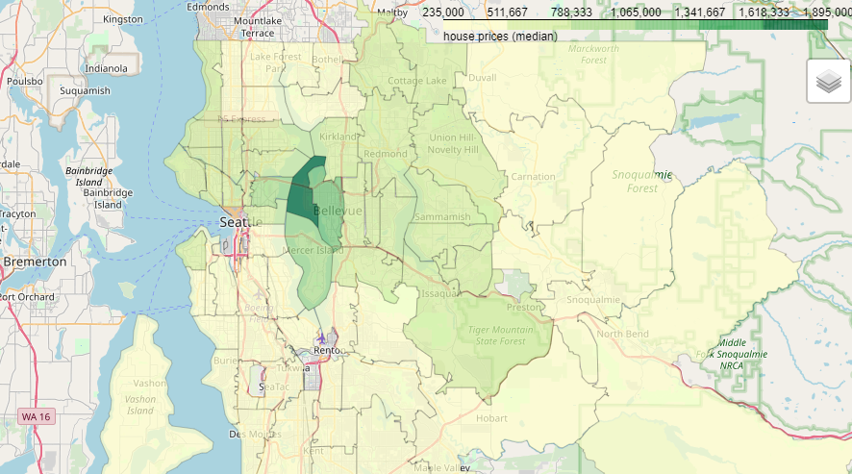
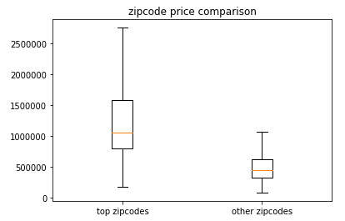
top
zipcodes
54% price increase
Bellevue
Medina
Clyde Hill
Mercer Island
East Seattle
location

Slide 8
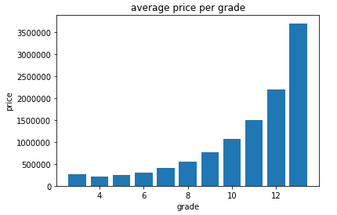
grade
condition
condition
Grade can increase price up to 180%
1. Falls short of minimum building standards. Normally cabin or inferior structure.
...
13. Generally custom designed and built. Mansion level. Large amount of highest quality cabinet work, wood trim, marble, entry ways etc.
Condition 1 - 3 to 5 - 6 can increase price up to 12%

Slide 9
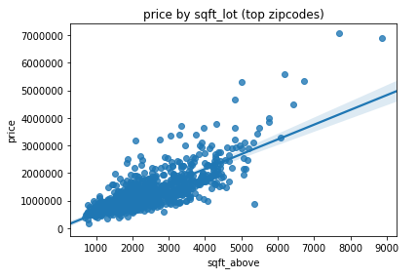
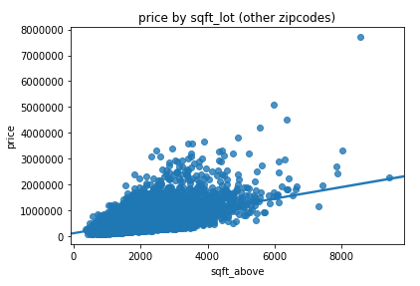
square
footage
1,000 sqft to 1,100 sqft:
15% price increase
features
However…
look at the living square footage!

Slide 10
final recommendations
waterfront – 75% up
top 4 zipcodes – 50% up
grade instead of condition – up to a 180%
living area instead of total square footage

Slide 11
thank you.

